Slide 1
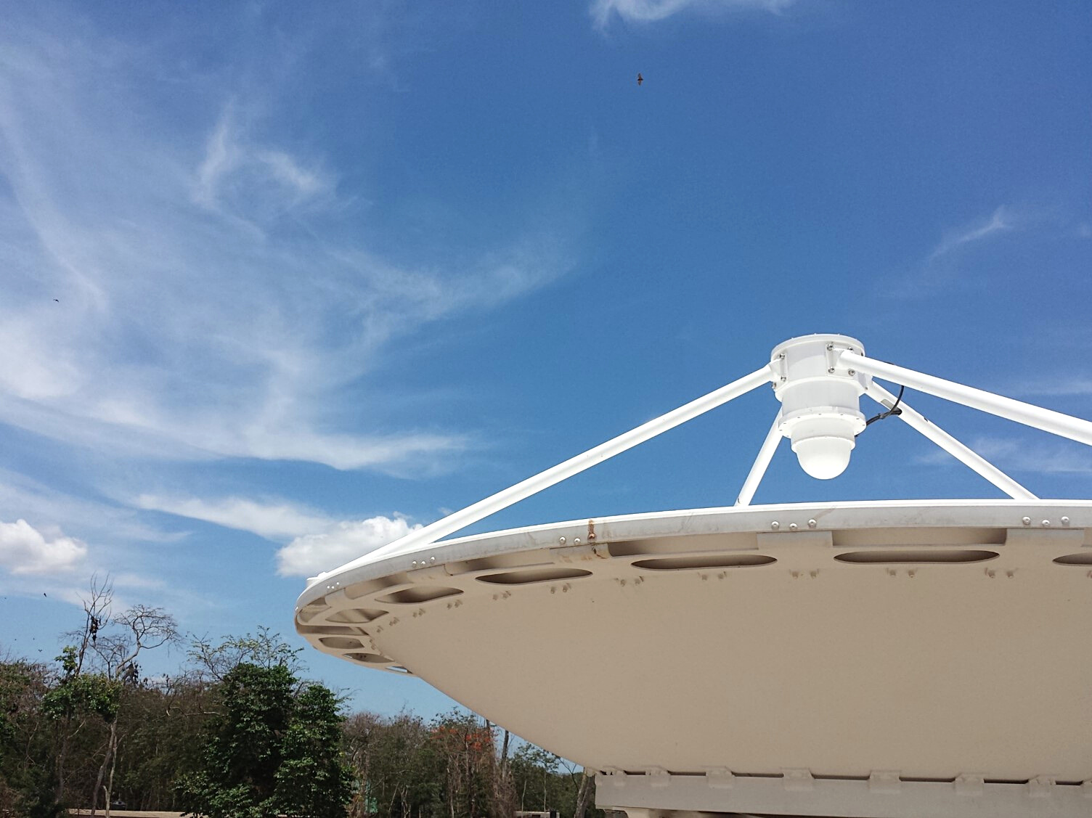
Brief Overview of EORIC's Activities & Infrastructure
Earth Observation Research & Innovation Centre (EORIC)
Notes:
My name is Ing. Dr Emmanuel Nyantakyi and I will be making a short presentation on some of the activities of the Earth Observation Research & Innovation Centre of the University of Energy & Natural Resources in Sunyani.

Slide 2
ABOUT UENR
The University of Energy and Natural Resources (UENR) is a public-funded institution that was established by an Act of Parliament, Act 830, 2011 on December 31, 2011.
The University is a multi-campus set-up and currently has three campuses located in Sunyani, Nsoatre and Dormaa Ahenkro.
SCHOOLS IN UENR
School of Engineering
School of Sciences
School of Geosciences
School of Agriculture and Technology
School of Natural Resources
School of Management Sciences and Law
School of Graduate Studies
01–20
Notes:
I will start by first talking briefly about the university.
The University of Energy and Natural Resources (UENR) is a public-funded institution that was established by an Act of Parliament, Act 830, 2011 on December 31, 2011, and it operates a multi-campus setup and currently has three campuses located in Sunyani, Nsoatre and Dormaa Ahenkro.
The University operates under the following schools
• School of Engineering
• School of Sciences
• School of Geosciences
• School of Agriculture and Technology
• School of Natural Resources
• School of Management Sciences and Law
• School of Graduate Studies
UENR approaches its programmes and research by emphasizing interdisciplinary collaboration and taking into account areas such as economics, law and policy, management, science, technology and engineering, and social and political issues affecting energy and natural resources.

Slide 3
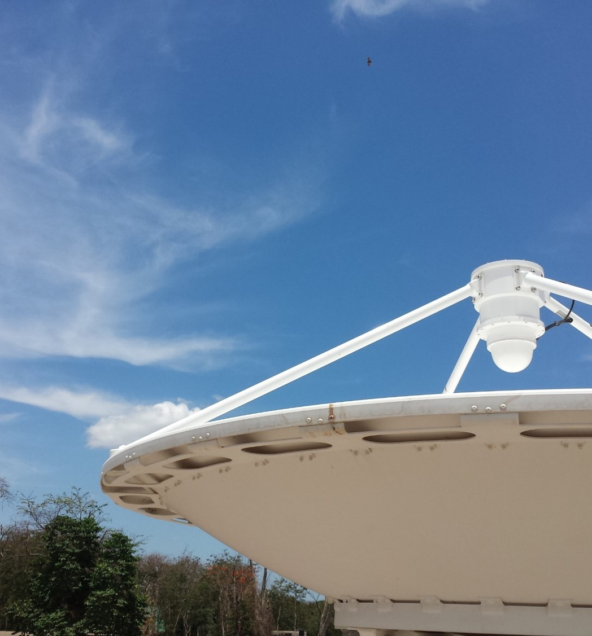
ABOUT EORIC
EORIC is a research arm of the University of Energy and Natural Resources (UENR)-Sunyani
Started as GEONETCast Centre in 2013 and was rebranded as EORIC in 2016
RESPONSILITIES
Acquisition of near-real-time satellite data
Acquisition of airborne & in-situ data, metadata and products
Weather monitoring
UAS operations & management
Virtual fire monitoring & modelling
Organizing training programs
Consultancy Services
Conducting Research
02–20
Notes:
EORIC was birthed in 2013 and was known as the GEONETCast Centre following the installation of a GEONETCast Reception Station during the administration of the Foundation Vice-Chancellor, Prof. Esi Awuah with Prof. Amos T. Kabo-Bah as the Foundation Head.
With growing issues and developments within the GEONETCast Centre, the academic board agreed to rebrand the Centre in March 2016 as Earth Observation Research and Innovation Centre (EORIC).
This branding was to showcase the Centre as a vibrant research arm of the University of Energy and Natural Resources (UENR)-Sunyani, responsible for the acquisition of near real-time satellite-based data, airborne and in-situ data, metadata and products, automatic weather monitoring, operations and management of unmanned aerial systems, virtual regional fire monitoring and modelling, organization of training programs in the use of Earth Observation (EO) and Geographic Information Systems (GIS) techniques, collectively towards making informed decisions in the areas of water, disasters, health, energy, climate, agriculture, ecosystems and biodiversity.
EORIC also engages in interdisciplinary research that cuts across its current divisions and currently has over 30 publications spread across several peer-reviewed journals.

Slide 4
VISION
To become a leading African Research Centre in the promotion and dissemination of value-added satellite and in-situ based data and information, transfer of ultra-modern affordable space science skills and technologies for meeting the needs of society
MISSION
GEO WEEK 2022 GHANA
To promote, facilitate and support the acquisition and application of geospatial technologies in interdisciplinary research and education in areas of water, disasters, energy, climate, agriculture, ecosystems, weather, health and biodiversity
DIVISION
- Air, Weather & Climate Informatics
- Earth & Ocean Observation
- Satellite Operations & Communication
- Matter & Energy Fluxes
- Innovative Geo-Computing
- Unmanned Aerial Systems
03-20
Notes:
The vision and mission statements of the centre have been outlined here.
EORIC currently has the following division;
• Air, Weather & Climate Informatics
• Earth & Ocean Observation
• Satellite Operations & Communications
• Matter & Energy Fluxes
• Innovative Geo-Computing
• Unmanned Aerial Systems
• Projects, Services & Partnership Office
• Technical Support Office

Slide 5
PARTNERS
The Centre currently collaborates with both international and local institutions and organisations including:
National Oceanic & Atmospheric Administration (NOAA), USA
University Corporation for Atmospheric Research (UCAR), USA
ATLAS Space Operations-USA, Orbital Systems – USA
MB-Satellite – Germany
Ghana National Fire Service
Skills Development Fund (SDF)
AIMS-Ghana
NDPC-Ghana
COCOBOD-Ghana
CzechGlobe
National Disaster Management Organisation
Forestry Commission (NADMO)
Forest Research Institute
04–20
Notes:
The Centre currently collaborates with both international and local institutions and organisations including
- National Oceanic & Atmospheric Administration (NOAA), USA
- University Corporation for Atmospheric Research (UCAR), USA
- ATLAS Space Operations-USA, Orbital Systems – USA
- MB-Satellite – Germany
- Ghana National Fire Service
- AIMS-Ghana
- CzechGlobe
- National Disaster Management Organisation
- Forestry Commission (NADMO)
- Forest Research Institute
among others.
In 2017, the Centre hosted the AfriGEOSS Symposium in Sunyani on the theme “Delivery Earth Observations for Policy and Sustainable Societal Impact in Africa”. The Symposium brought together over 160 national and international experts, from government departments, intergovernmental organizations, education and research institutions, national remote sensing centres, space institutes and agencies, industry and not-for-profit organizations, with a shared interest in closing data gaps and enabling improved access and uptake of Earth observations in societal benefit areas including as food security and agriculture, water resources management, urban development, forest management, climate change adaptation and land.
Let's move ahead to look at some of the existing infrastructure and activities of the centre.

Slide 6
01
EARTH OBSERVATION SATELLITE - DIRECT BROADCAST - EOS-DB GROUND STATION
The 2.4m high-quality, high-precision elevation-over-azimuth satellite tracking antenna system was installed in 2015 for acquisition of Earth Observing Satellite-Direct Broadcast data from Low Earth Orbit (LEO) and Medium Earth Orbit (MEO) Satellites.
GEO WEEK 2022 GHANA
SATELLITES
FUNDED BY
NASA Terra
NASA Aqua
Suomi NPP
NOAA 18
NOAA 19
Metop-A
Metop-B
FENGYUN 3B
NATIONAL PARTNERS
INTERNATIONAL PARTNERS
05–20
Notes:
The Centre can boast of several unique infrastructures.
The EOS was the 2nd antenna to be installed in the university in 2015 with funding from the Skills Development Fund.
It started as part of a project for the development of a curriculum for the fire & disaster management course in UENR.
This 2.4m dish antenna tracks satellites from Low Earth and Middle Earth Orbits namely;
1. NASA Terra
2. NASA Aqua
3. Suomi NPP
4. NOAA 18
5. NOAA 19
6. Metop-A
7. Metop-B
8. FENGYUN 3B
The data received from this system are Level zero (0) meaning that they have not been processed.

Slide 7
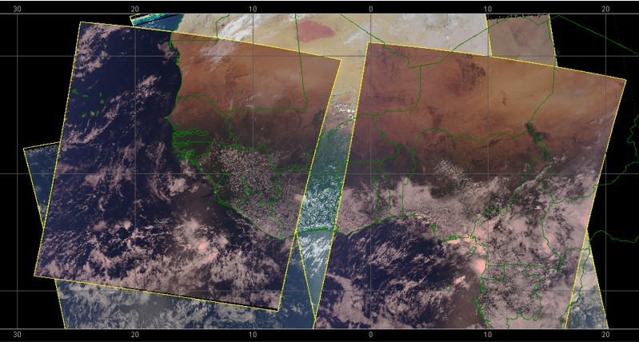
Coverage
GEO WEEK 2022 GHANA
06–20
Notes:
Even though the EOS is located in Sunyani it covers an aggregated swath area.
The combined swath area covers West Africa, parts of East and North Africa and Level zero data is being collected 24/7 from all the satellites mentioned earlier.

Slide 8
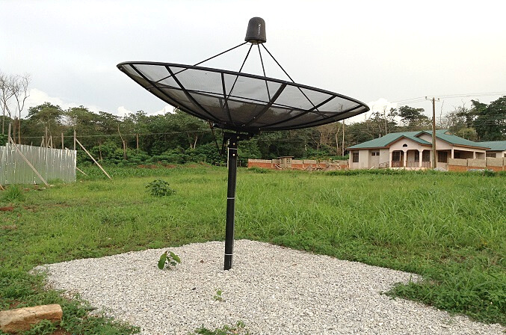
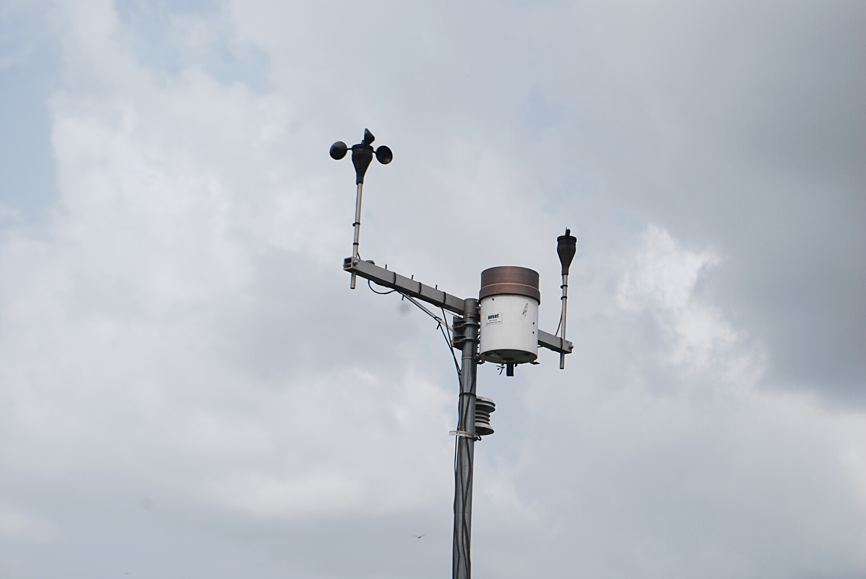
02
03
GEO WEEK 2022 GHANA
GEONETCAST RECEPTION STATION
AUTOMATIC WEATHER STATION
The 3m mesh, C Band antenna was installed in 2013 for decoding the signal and recreates the data/products according to a defined directory and the file name structure from the Eutelsat 8W.
The automatic weather station established on the 2nd of June 2014 and started successfully logging data on the 4th of June 2014. The Automatic Weather Station provides daily weather data for the Centre.
07–20
Notes:
The GEONETCast Reception station was the first to be installed at the centre.
The station consists of a 3m antenna that receives data from satellites positioned in the geostationary orbit.
The information downlinked from this antenna is majorly for meteorological purposes.
The 3rd one is an Automatic Weather Station installed in 2014 to collect in-situ based data on prevailing weather conditions

Slide 9
GEO WEEK 2022 GHANA
AVFS
Advanced Virtual Fire System
08–20
Notes:
The centre’s existing infrastructure provides satellite data that covers the whole of West Africa and parts of Northern and East Africa.
The EOS satellite receiver is one of its kind in West Africa and is currently processing MODIS and VIIRS satellite data to offer real-time fire detection services to various stakeholders in the country.
In line with our vision and mission statement, the centre seeks to promote real-time web-based forecasting models for the management of disasters such as flooding and fire outbreaks.
The Advanced Virtual Fire Information System is an integrated ICT platform focused on the prediction, detection and assessment of fires.
AVFS utilises a portfolio of satellites to provide both high-frequency as well as high-resolution active fire detections.
Data from the MODIS sensor on the NASA Aqua and Terra satellite and the VIIRS sensor onboard the Suomi NPP Satellite are quickly processed and fed into the system.
AVFS also provides weather information to farmers and all other stakeholders.

Slide 10
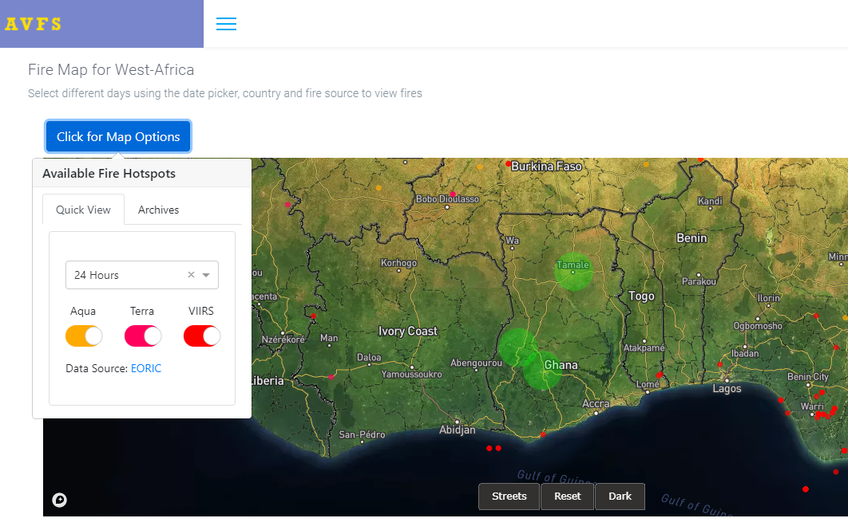
Web Application
GEO WEEK 2022 GHANA
09-20
Notes:
Here we have a snapshot of the web application.
Farmers and Stakeholders can select a number of points of interest that will trigger notification alerts whenever the system detects any fires within a specified radius.
Farmers are also furnished with a 5day 6 hourly weather forecast.

Slide 11
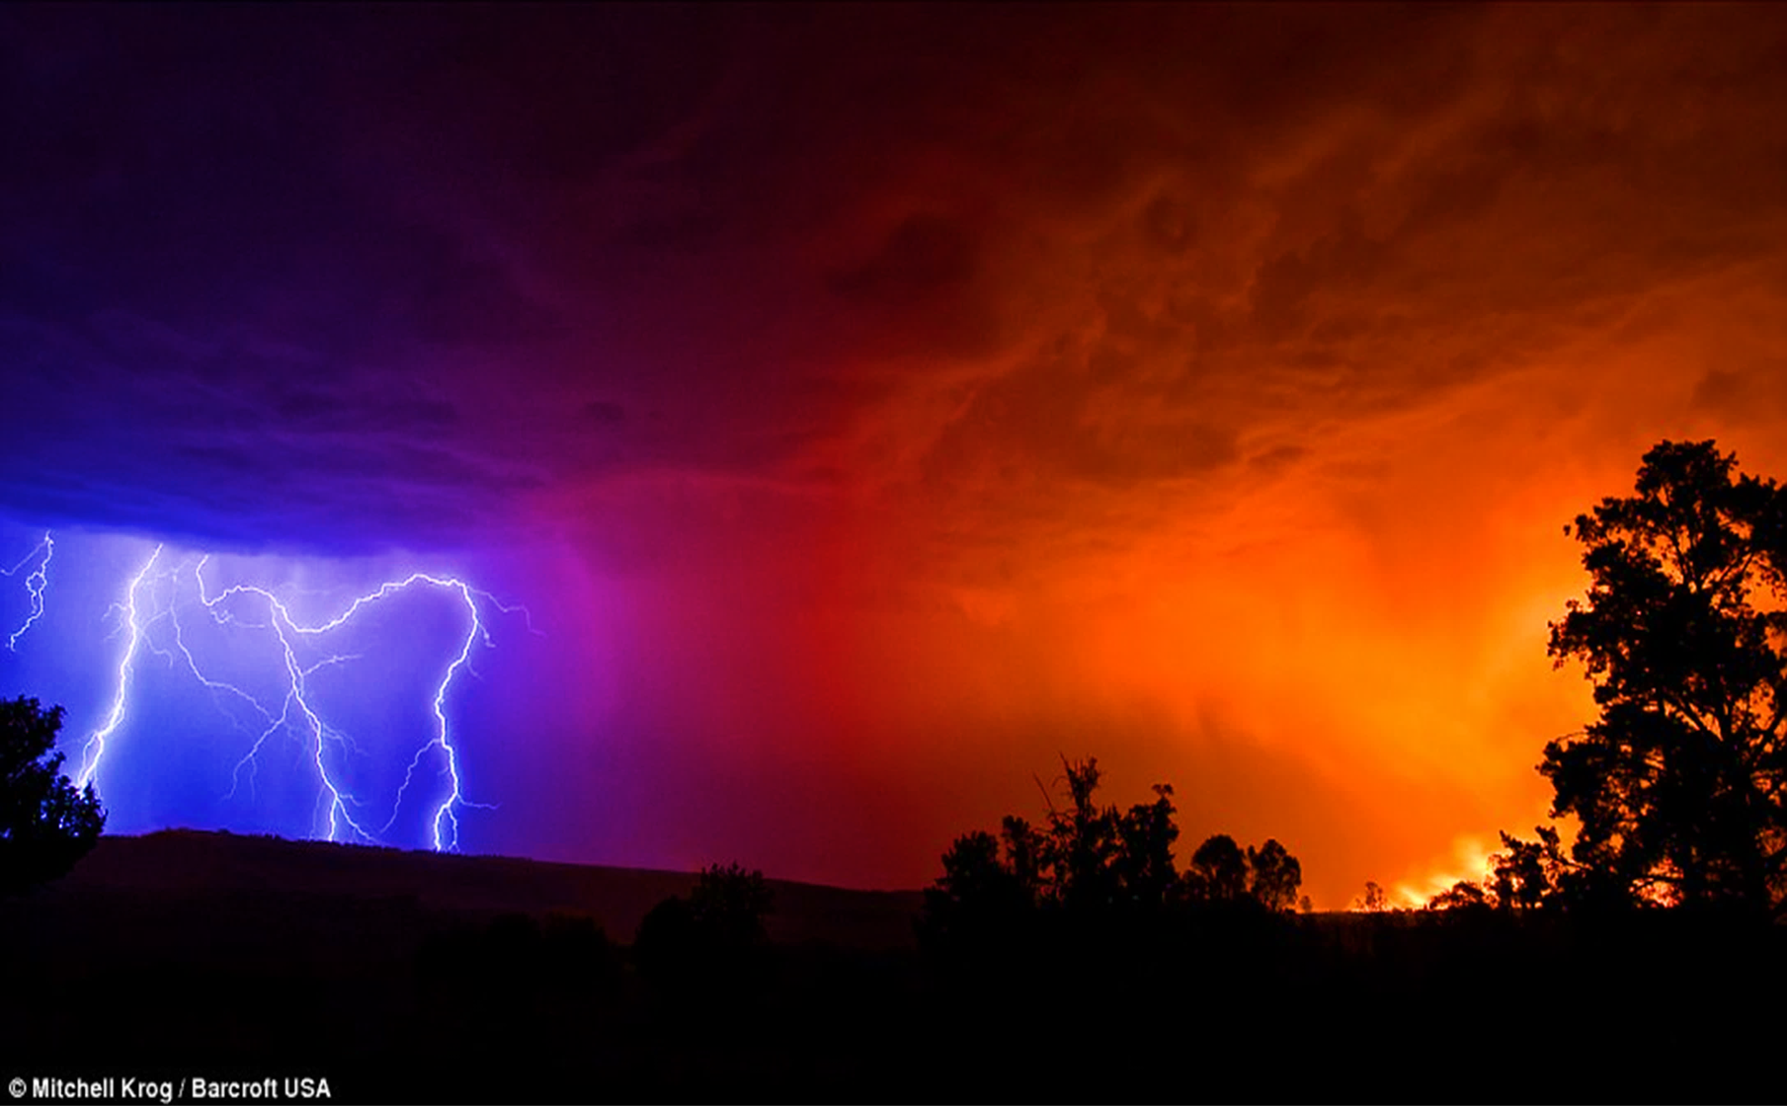
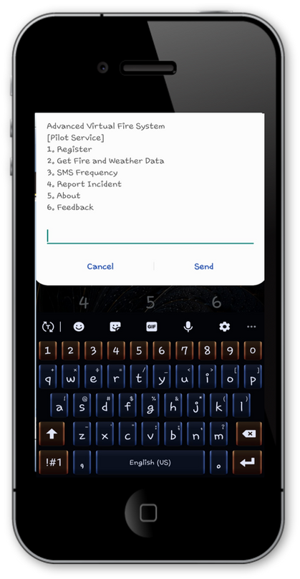
USSD Application
"Currently Yendi feels like 28 deg and will experience overcast clouds. The average temperature is about 26 deg with humidiy of 79%. Winds will blow at speed of 3.66m/s in the SW direction. 2 fires were detected in your location"
GEO WEEK 2022 GHANA
Short code
MOBILE APPS
*920*49#
Available on both iOS and Android, AVFSMobile brings critical fire management information to you where ever you are. Automated alerting to SMS, email or push notifications
10-20
Notes:
The centre also designed a USSD application to serve users in areas will poor data coverage.
The pilot project has currently ended and the university is looking forward to a World Bank grant to include more features and upscale the service for the whole of Africa.

Slide 12
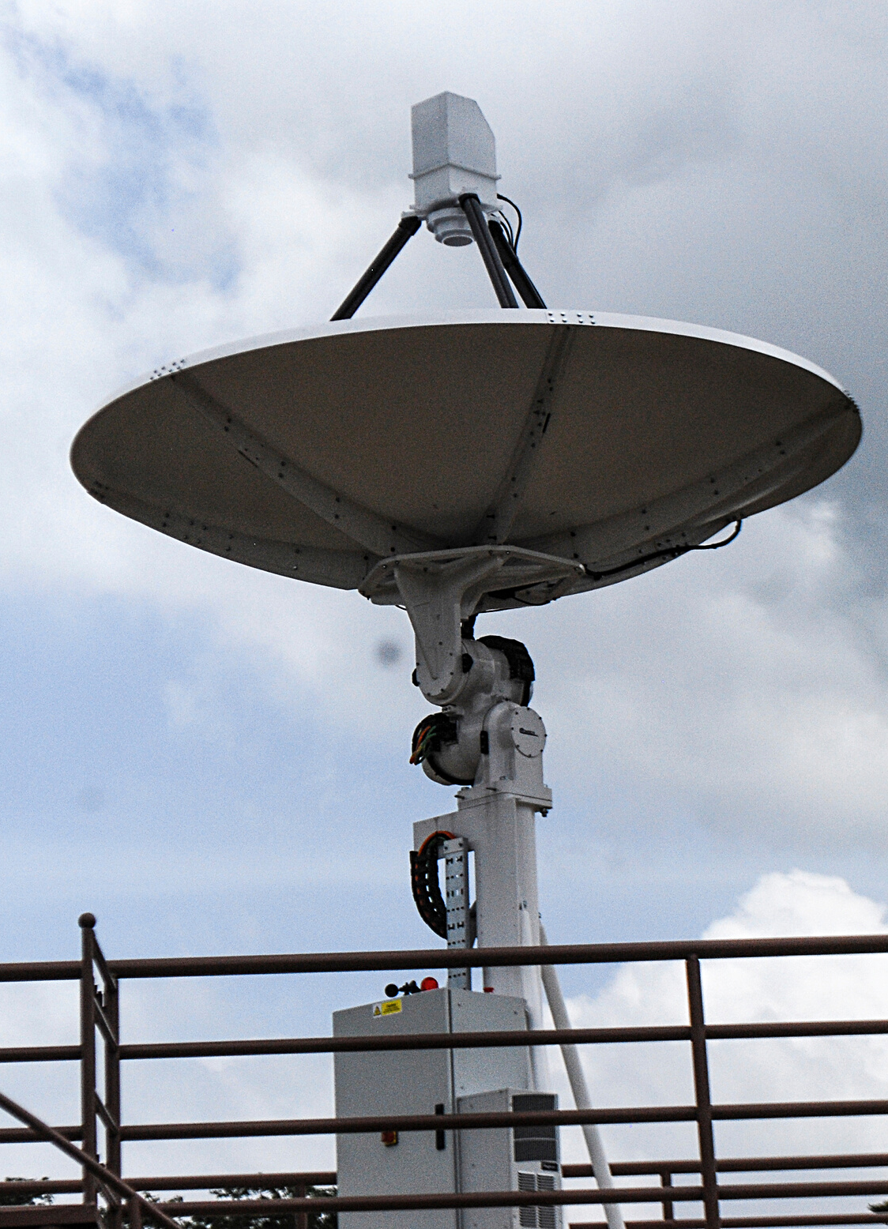
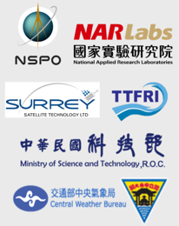
04
FORMOSAT-7 / COSMIC-2 (CONSTELLATION OBSERVING SYSTEM FOR METEOROLOGY, IONOSPHERE AND CLIMATE)
The COSMIC-2 mission is a collaboration between National Oceanic. Atmospheric Administration (NOAA-USA), the United States Air Force and the National Space Organization of Taiwan, with the goal of obtaining Global Navigation Satellite System Radio Occultation (RO) Data worldwide.
GEO WEEK 2022 GHANA
PARTNERS
11–20
Notes:
So here we have what we call the COSMIC-2 Groundstation
The Constellation Observing System for Meteorology, Ionosphere, and Climate-2 (COSMIC-2) is a network of six remote-sensing microsatellites.
Building upon the success of the COSMIC-1 program, COSMIC-2 will constantly orbit Earth collecting atmospheric data used for weather forecasting, climate monitoring, and space weather research.
NOAA is partnering with the U.S. Air Force (USAF), Taiwan’s National Space Organization (NSPO), and the University Corporation for Atmospheric Research (UCAR) on this satellite program.
COSMIC-2 utilizes a network of downlink stations to receive data and route them for processing.
The one in UENR forms part of 10 other ones in the whole world!!!
The COSMIC-2 Groundstation is capable of TT&C which is Telemetry, Tracking & Control and in 2018, the centre together with its partner, ATLAS Space Operations supported the United States Air Force Academy’s (USAFA) FalconSat-6 satellite launch.

Slide 13
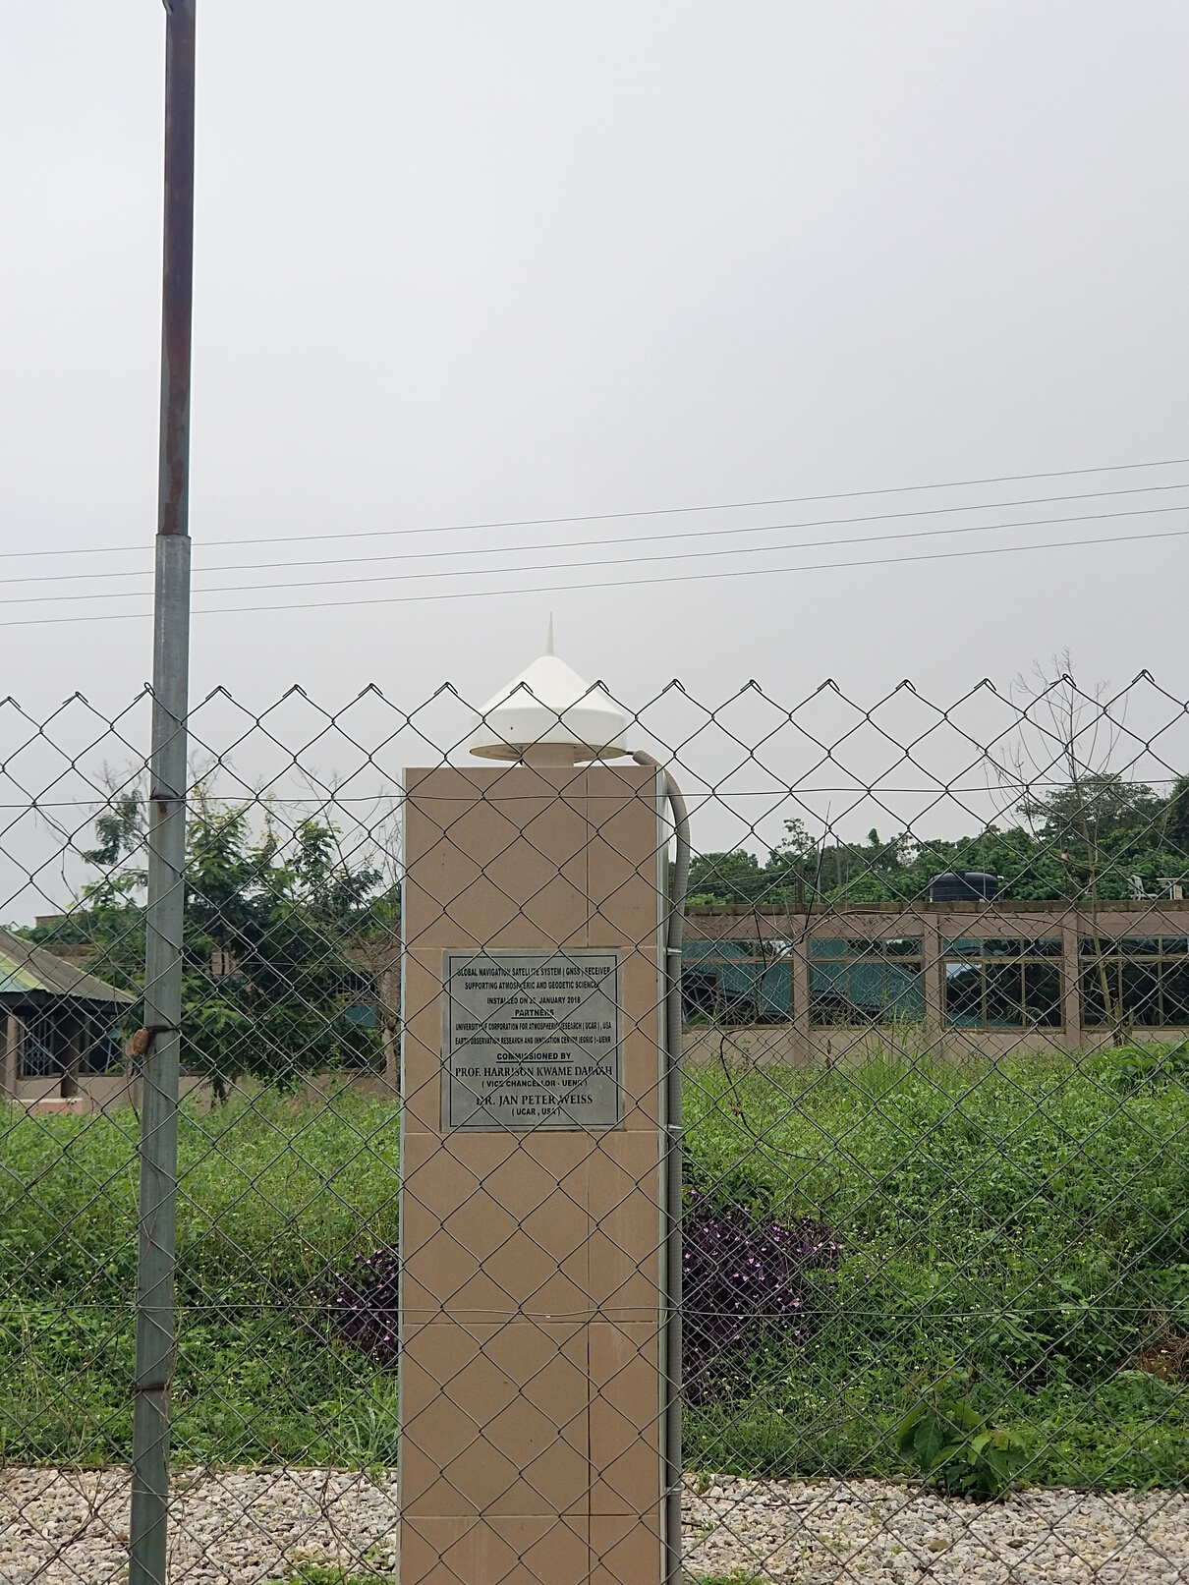
05
GLOBAL NAVIGATION SATELLITE SYSTEM (GNSS)
The stationary GNSS receiving station was installed in 2018 to support the COSMIC-2 program and other applications. University of Energy and Natural Resources and University Corporation for Atmospheric Research (UCAR) jointly operate the station through a partnership.
GEO WEEK 2022 GHANA
PARTNERS
12–20
Notes:
The GNSS referencing station was also installed by UCAR in UENR to support the COSMIC-2 Program and other applications.
The system works using a satellite remote sensing technique called Radio Occultation that uses GNSS (e.g., GPS) measurements received by low-Earth orbiting satellites to profile the Earth's atmosphere and ionosphere with high vertical resolution and global coverage.
The high accuracy and vertical resolution of GNSS-RO data make them ideally suited to study:
• Weather forecasting and atmospheric processes
• Climate monitoring and model verification
• Space weather and ionospheric research

Slide 14
WEATHER FORECASTING
06
The Weather and Climate unit at the Earth Observation Research and Innovation centre in the University of Energy and Natural Resources engages in research activities to support climate change adaptation and risk assessment. We focus on weather extremes, their impacts, variability, predictability and change. We also promote tailoring the weekly to monthly forecasts for the public, specifically for the Northern half of the country.
GEO WEEK 2022 GHANA
FORECAST OUTLETS / MEDIA,
13–20
Notes:
EORIC also shares weather information with the university community and people within the region.
And we do so cautiously by stating a disclaimer that it is meant solely for research purposes since the Ghana Meteorological Agency is nationally mandated to do so officially.
The centre makes use of satellite data and some models to forecast and predict weather conditions.
EORIC's daily forecasts are shared via the University's Radio station and others in Sunyani.

Slide 15
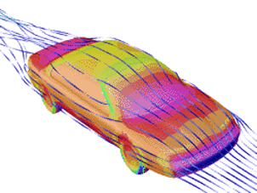
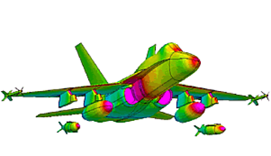
07
HIGH PERFORMACE COMPUTING (HPC)
The HPC Lab offers consultancy, research and training in High Performance Computing, Computational Fluid Dynamics (CFD) and Artificial Intelligence (AI) as well as develop new tools and software packages to address specific challenges.
GEO WEEK 2022 GHANA
APPLICATIONS
Computational Fluid Dynamics
GPU Computing
Environmental Modelling
Weather & Flood Forecasting
Artificial Intelligence
... and many more
PARTNERS
14–20
Notes:
The High-Performance Computing Unit handles the storage, processing and management of all data received at the centre.
They also run and interpret weather models and assist students and researchers in CFD, artificial intelligence and Deep learning-related tasks.

Slide 16
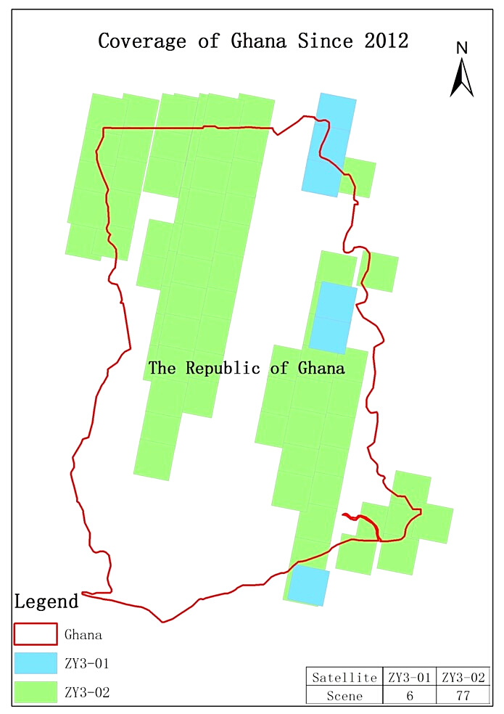
ZY3 CLOUD SERVICE PLATFORM
ZY3 is an advanced remote sensing satellite capable of providing high-resolution stereo and multispectral imagery. ZY3 is equipped with three panchromatic cameras and one multispectral camera (4 bands), which can provide high- resolution stereo imagery and multispectral imagery.
The project is a partnership between the University of Energy and Natural Resources (UENR) and the Satellite Surveying and Mapping Application Centre (SASMAC), National Administration of Surveying, Mapping and Geoinformation (NASG), P.R. China
08
GEO WEEK 2022 GHANA
PARTNERS
DATA PRODUCTS
Sensor-Corrected Products(SC Products)
Digital Orthophoto Map(DOM)
Digital Surface Model(DSM)
15–20
Notes:
EORIC-UENR serves as one of the international nodes that receive ZY3 satellite data through its cloud service platform.
The project is a partnership between the University of Energy and Natural Resources (UENR) and the Satellite Surveying and Mapping Application Centre (SASMAC), National Administration of Surveying, Mapping and Geoinformation (NASG), P.R. China
The data can be used for Mapping and resource investigation. Since the satellite has the ability to generate multispectral imagery, the data can be used for territorial resource investigation and monitoring, and to provide services for disaster warning and reduction, agriculture, forestry, water conservation, ecological environment, and so on.

Slide 17
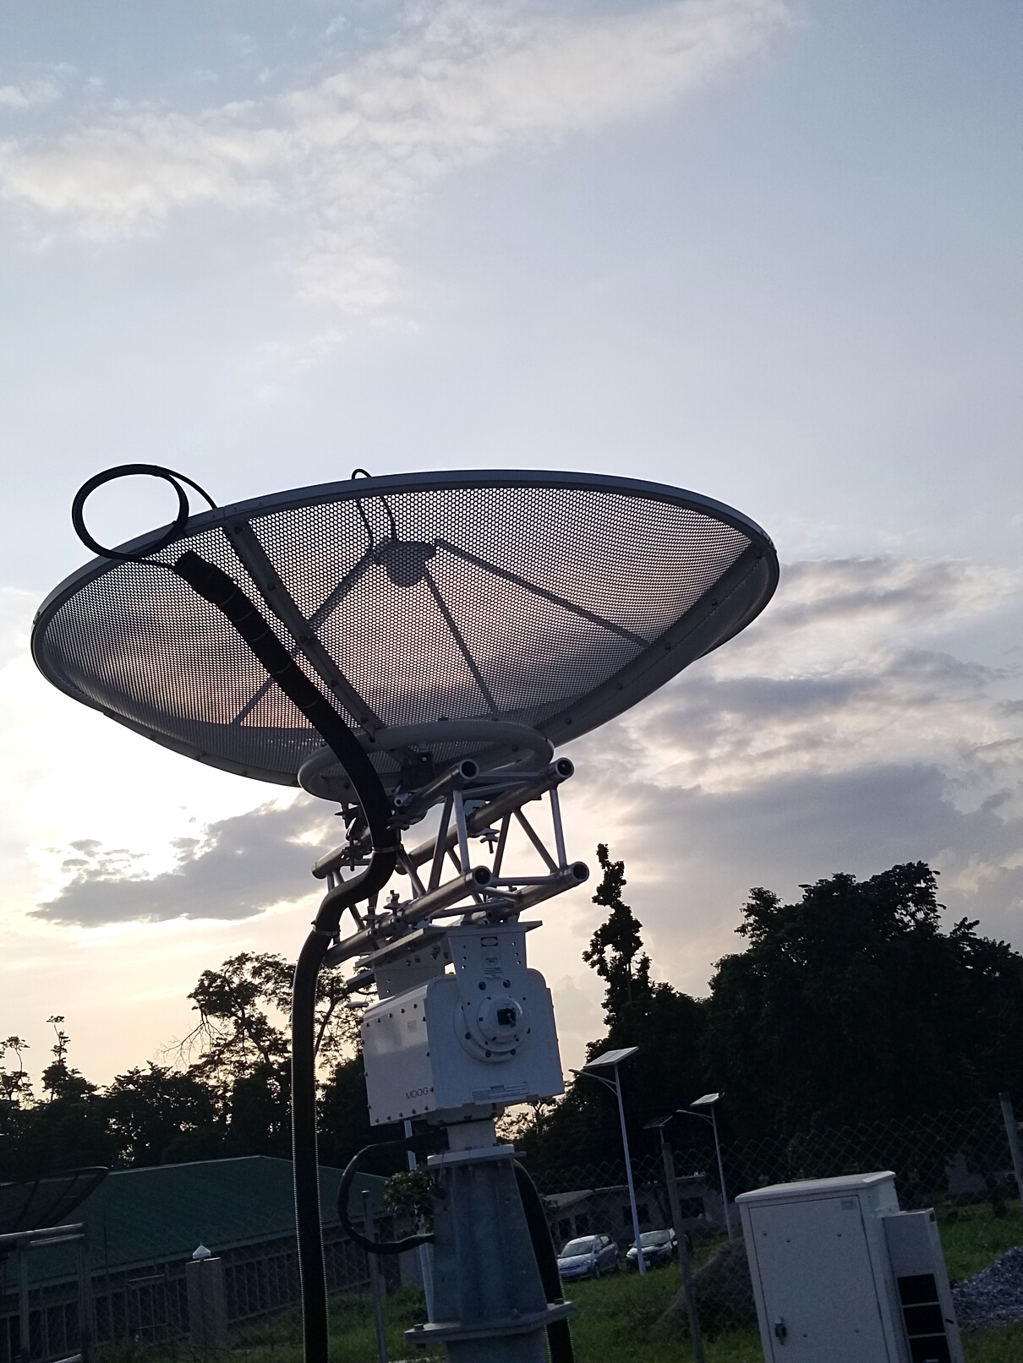
09
COLOCATION SERVICES-SPIRE PROJECT
EORIC-UENR is providing colocation services for MEDIA BROADCAST SATELLITE GMBH in Germany to support the SPIRE Mission.
The 1.5-metre antenna collects a rich and unique data set for tracking the oceans, skies and weather 24/7
GEO WEEK 2022 GHANA
PARTNERS
16–20
Notes:
Presently, EORIC manages and maintains four (4) satellite ground stations for the acquisition of remote sensing and earth observation data for research and educational purposes.
As seen earlier, which includes two full-motion antennas that support Telemetry, Tracking and Command (TT&C), one fixed antenna and one Global Navigation Satellite System (GNSS) referencing station. These ground stations operate across L, S, X and C frequency bands.
EORIC-UENR also provide colocation services for one of SPIRE Global's antennas.
These services include providing secure location, power and backup power, stable internet connectivity and technical expertise to manage and maintain their antennae.
Engineers at EORIC installed and maintain this antenna and all other existing infrastructure at the centre.

Slide 18
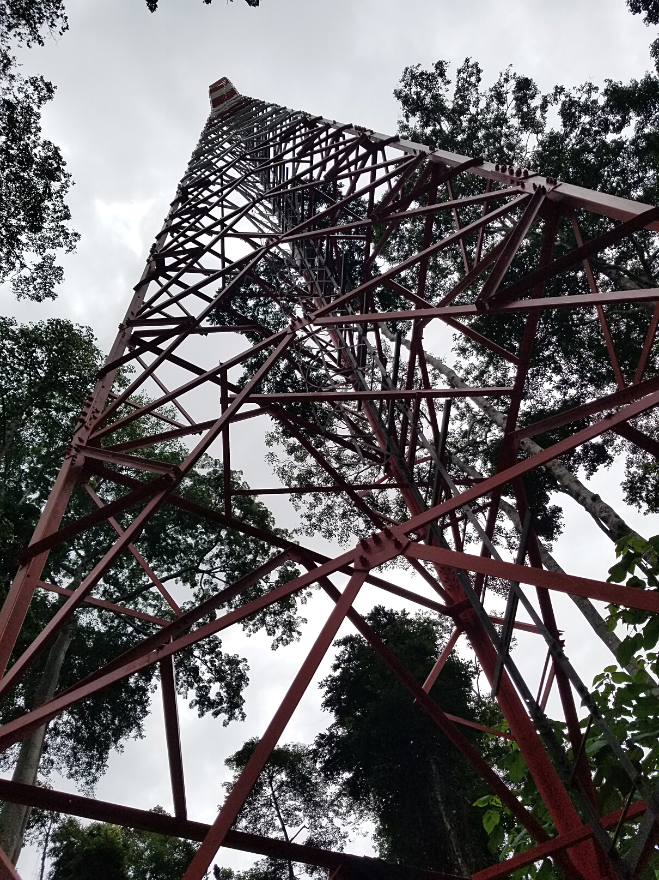
09
CARBON MONITORING TOWER (UPCOMING)
The project is a cooperation between the University of Energy and Natural Resources in Sunyani, Ghana and the Global Change Research Institute, Czech Academy of Sciences, The Czech Republic. The project site will be a national asset to support climate change research and national efforts in addressing and reporting on SDG Goal 13 – Climate Action
GEO WEEK 2022 GHANA
PARTNERS
17–20
Notes:
The carbon Tower project is between UENR and the CzechGlobe to enhance climate research in a typical tropical dense forest area.
The station will comprise an eddy covariance sensor mounted on top of a 70-m flux tower. This eddy covariance the sensor will provide data on;
CO2 & water vapour fluxes between the forest ecosystem & atmosphere
Vertical profile of air and soil temperature & humidity, radiation etc.
3 PhD students are benefitted from the project and also 1 Technician has been trained to manage and maintain the station.
As part of leveraging on the data to be received from the station, an MoU has been UENR & AIMS-Ghana have been agreed to commence a programme in
Climate Change & Atmospheric Physics (CAPP)

Slide 19
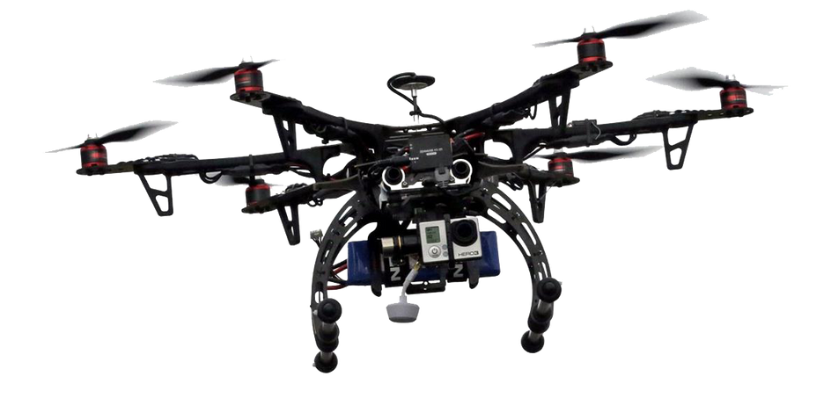
10
UNMANNED AERIAL SYSTEMS
Unmanned Aerial Systems for remote sensing, precision agriculture. We also provide consultancy and a range of courses for those individuals looking to use drones for a variety of purposes.
GEO WEEK 2022 GHANA
MODULES
BASIC MODULE
PROFESSIONAL
Drone Technology Background
Full Day Training with Flight Time
Drone Simulation Training
Learn to Fly Before
Be Ready to Turn Your Hobby into a Profession
Learn the Rules for Safe and Legal Professional Flights
Contact us for more information:
eoric@uenr.edu.gh
https://eoric.uenr.edu.gh/
SPECIALIZED
Drone Mapping & Surveying
3D modelling
Precision Agriculture
Drone Assembly and Repairs
18–20
Notes:
We also provide consultancy and a range of training courses for those individuals looking to use drones for a variety of purposes such as
• Drone Mapping & Survey
• Multispectral imaging
• Precision Agriculture etc.

Slide 20
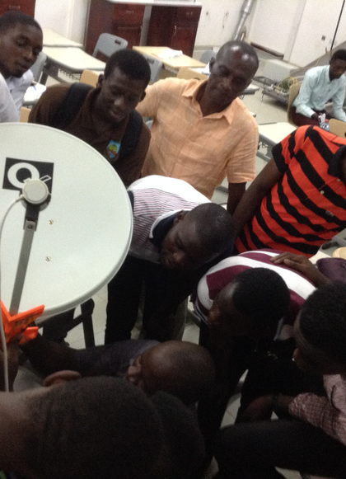
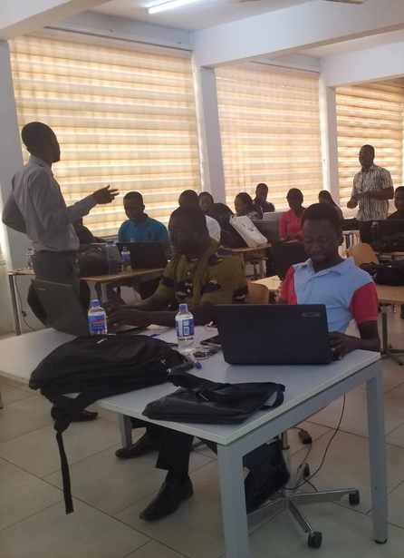
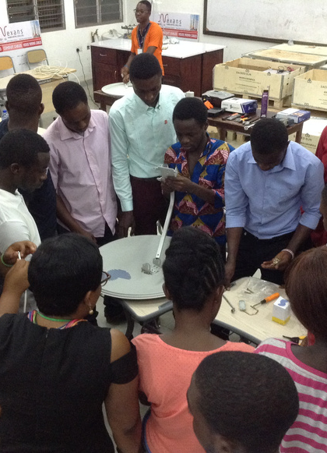
11
TRAINING, INTERNSHIP, ATTACHMENT PROGRAMMES
EORIC offers hands-on workshops and training in a wide range of areas to solve real-world problems. Our training targets students, interns and professionals. Watch out for our next training happening soon.
Interns and Attaches are welcomed to work and learn hands-on with us.
GEO WEEK 2022 GHANA
TRAININGS PROGRAMMES & WORKSHOPS
FUNDAMENTALS OF ACCELERATED COMPUTING WITH CUDA C/C++
INTRODUCTION TO COMPUTATIONAL FLUID DYNAMICS WITH OPENFOAM
SATCOM PROFESSIONAL CERTIFICATE SHORT COURSE
GEOSPATIAL ANALYSIS WITH R
UNDERSTANDING DVBS2, DVBT2 & DVB-H IN SATELLITE TECHNOLOGY
APPLIED REMOTE SENSING FOR VEGETATION MAPPING
APPLIED SATELLITE TECHNOLOGY FOR INTEGRATED RESOURCE MANAGEMENT
INTRODUCTION TO DATA ANALYSIS WITH PYTHON
INTRODUCTION TO DRONE FLIGHT AND DATA PROCESSING
INTRODUCTION TO LATEX
19–20
Notes:
The centre offers a number of training programmes and workshops in areas that relate to EO, GIS, UAS, Deep learning, CFD and satellite technologies.
EORIC runs a special satellite installation programme from basic to advanced level. The programme is modelled around the GVF course, which is the Global VSat Forum, an internationally accredited satellite installer program
The centre is open to self-motivated students and people to enrol on its well-structured internship/attachment program, where interns/attaches are taken through a series of technical and hands-on training and mentoring by research fellows and technicians.
Over the years, we have had over 30 interns, attaches, post-doc researchers.

Slide 21
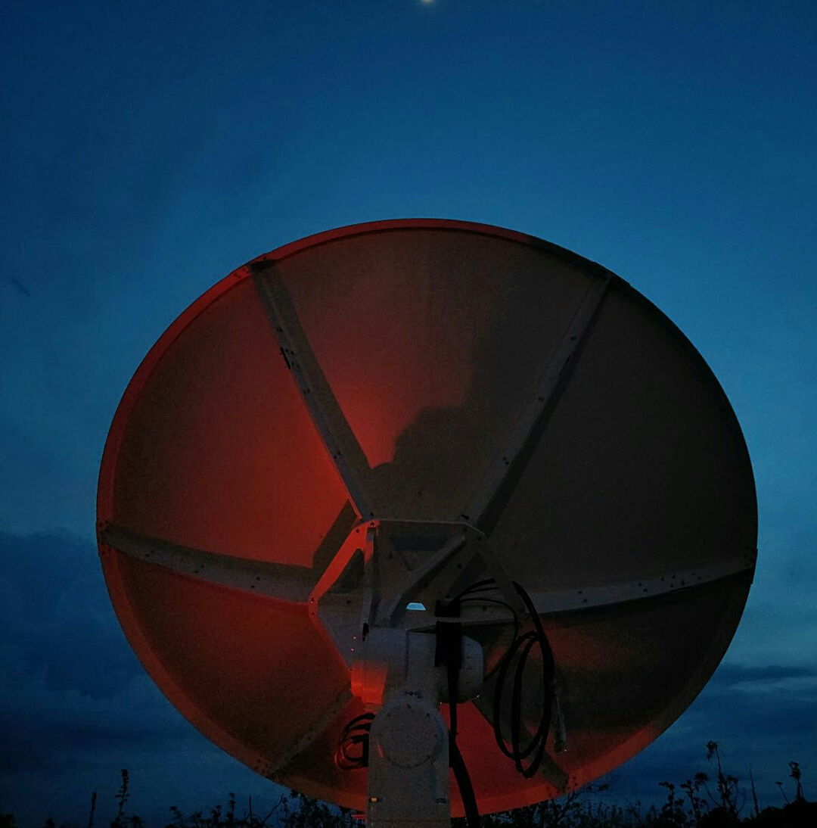
Contact Information
WEBSITE
https://uenr.edu.gh/
http://eoric.uenr.edu.gh/
MOBILE PHONE
+233 24 848 0088
EMAIL ADDRESS
eoric@uenr.edu.gh
GEO WEEK 2022 GHANA
20–20
Notes:
In conclusion, EORIC continues to pursue its vision of becoming a centre of excellence in geospatial data acquisition and analysis through collaborative partnerships, impactful and innovative research and capacity building.
Thank you.

